Slide 1

NCRM April 2024 – Intro to Python for data analysis: Session 8: EDA and descriptive statistics
Lewys Brace
l.brace@exeter.ac.uk

Slide 2
Basic mathematical notation

Slide 3

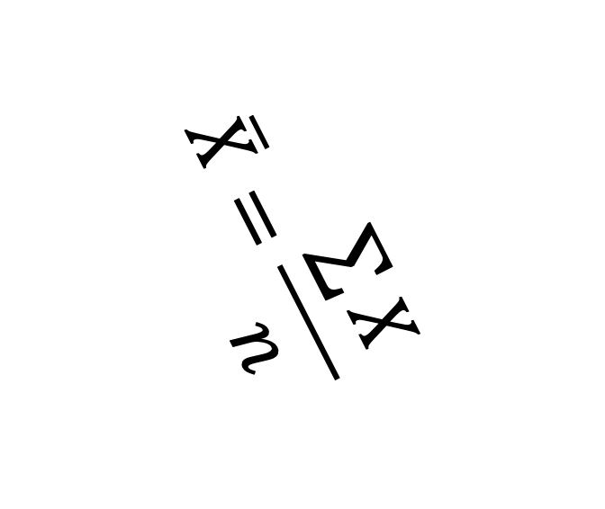
$$\overline{X}=\frac{\sum{X}}{n}$$

Slide 4
To convert a temperature in degrees C into degrees Fahrenheit, you take your temperature in C, times it by 1.8 and then add 32 to the result.
As an example, lets say we have a temperature of 20C, we times it by 1.8 which gives us 36, and we then add 32. This gives us 68 degrees Fahrenheit.
What we have really just gone through here is a formula for temperature conversion, just in word form. And that is the important thing I want you to remember here; maths is just a language.
With that in mind, how could we take the long detailed explanation for converting temperatures and present it in a more concise manner?

Slide 5

$$F=1.8C+32$$
Read the formula aloud, left to right.
The letters are quite arbitrary; X and Y are favourites.
As with any language, maths has a set of conventions to it. Just as adding the suffix of ‘ing’ to the end of the word ‘car’ changes its meaning, adding the C to the 1.8 above means that we don’t just use the 1.8 on it’s own.
Whenever you see a combination like this (i.e. 5Y, -8Z, etc), it means that you multiply the variable represented by C by the value of the number. So 1.8C means ‘1.8 times C’.

Slide 6


You may here some say that there is a need to ‘satisfy the equation’.
All this means is that you need to find the values to replace the letters which will make both sides of the equation equal.
$$F=1.8C+32$$
$$C=0$$
$$F=32$$
$$32=1.8 ×0+32$$

Slide 7
Order of Operations
One last thing that is important to cover here is algebraic logic, or the order of operations. In English we would say “the red ball”, not “ the ball red”; this is an example of the way in which natural languages have an internal logic that keeps them consistent. The same thing is true for maths.
You may have noticed that in our previous formula, we multiplied 1.8 by C before adding 32; as we can see on the left there. We still would have done it in this order if the formula had been written the way it is on the right.
We do this because without this convention, the formula would be ambiguous.
In general, where you have the choice between addition, subtraction, multiplication, and division, multiplication and division take precedence over addition and subtraction. In essence, it does not matter which way around you write this equation, so long as you follow this order of operations.
It is important to note that all scientific calculators are programmed to follow this convention of algebraic precedence. But most simple four-functions calculators are not.

Slide 8
However, regardless of what kind of logic your calculator follows, written algebra always obeys this convention.
Take, as an example, the following: 2+3x4=
If we gave this to a human calculator, they would probably produce the answer 20, following the logic of “2+3=5, times 4 = 20”.
However, if the question was presented as “Find the value of 2+3X, when X=4”, the calculation is still the same, but the rules of algebraic precedence gives higher priority to multiplication over addition. The answer to this algebraically ‘correct’ version is 14.

Slide 9
If you had a formula where you wanted to do addition first, you can use parentheses.
For example, if you wanted to reverse our temperature calculating formula to calculate Fahrenheit to Celsius:
C=(𝐹−32)÷1.8
Written this way, the calculations done within the parentheses will be done before the rest of the calculation; in other words, we calculate F-32 before dividing the result of this by 1.8.
There are 3 important things to note here.
1. When you reverse a formula like this, not only do you reverse the operators (x becomes / and + becomes -), but you also reverse the sequence.
2. If the equation above was entered into a simple four function calculator without the parentheses, you would get the wrong answer
3. The formulae above and below are identical, and will always be interpreted in the same way. It’s just that the layout below is often deemed to be the ‘neater’ representation.
𝐶= (𝐹−32)/1.8

Slide 10
Brackets Orders (i.e. exponents) Division Multiplication Addition Subtraction

Slide 11
Summary statistics

Slide 12
Graphing data is a great first step in your data analysis.
However, you are probably also going to want to produce a more succinct, numerical-based, summary of you data in order to compliment your graphical analysis.

Slide 13
Summarising
A crucial human skill is to be selective about the data that we choose to analyse and, where possible, to summarise the information as briefly and usefully as possible.
There are two useful questions to think about when summarising data:
1. What is a typical, or average, value of the data?
2. How widely spread are the data values?

Slide 14
What is a distribution?
For now, think of a distribution as just a set of measurements, numbers, or data points.
We could talk about the distribution of heads and tails results obtained when tossing a coin many times.
Another distribution might be the final exam scores of every student in a particular school system.
A third would be the predictions of global population in 2100 from 50 runs of a demographic simulation, each with a different random seed value.

Slide 15
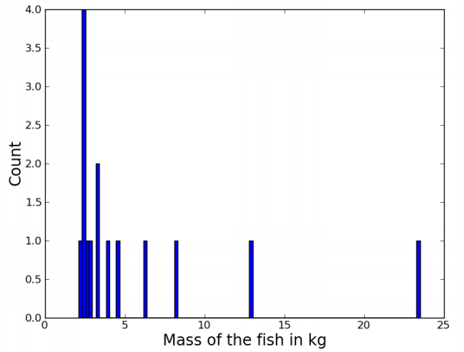
An example
Let's grab a sample distribution to work with:
[ 2.1, 2.4, 2.4, 2.4, 2.4, 2.6, 2.9, 3.2,
3.2, 3.9, 4.5, 6.3, 8.2, 12.8, 23.5]
These 15 numbers could be anything.
Let's say that they represent the mass in kilograms of some fish we've caught from a specific location.
Note that our scales are accurate to the nearest 100g.

Slide 16
Questions to ask about the distribution
Some natural questions to ask about any distribution are:
What's a typical score?
What's the range of the scores?
How spread-out are the scores?
Are the scores distributed evenly / symmetrically?

Slide 17
What is a typical score?
How heavy is a typical fish? In other words, where do our fish mass scores tend to cluster on the number line?
We need a measure of central tendency, options include:
- The mean, also known as the average, or the arithmetic mean.
- The median, or middle score in the range of data.
- The mode, the most frequently occurring score.

Slide 18
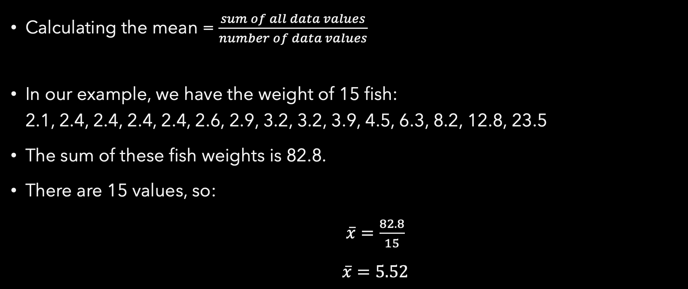

The mean ($\overline{x}$)
Calculating the mean = $\frac{sum of all data values}{number of data values}$
In our example, we have the weight of 15 fish: 2.1, 2.4, 2.4, 2.4, 2.4, 2.6, 2.9, 3.2, 3.2, 3.9, 4.5, 6.3, 8.2, 12.8, 23.5
The sum of these fish weights is 82.8.
There are 15 values, so:
$\overline{x}=\frac{82.8}{15}$
$\overline{x}=5.52$

Slide 19
The median
To calculate the median, order all data values in regards to their values from smallest to largest. The median value is then the middle value in the range of scores.
In our fish example: 2.1, 2.4, 2.4, 2.4, 2.4, 2.6, 2.9, 3.1, 3.2, 3.9, 4.5, 6.3, 8.2, 12.8, 23.5
median = 3.1

Slide 20
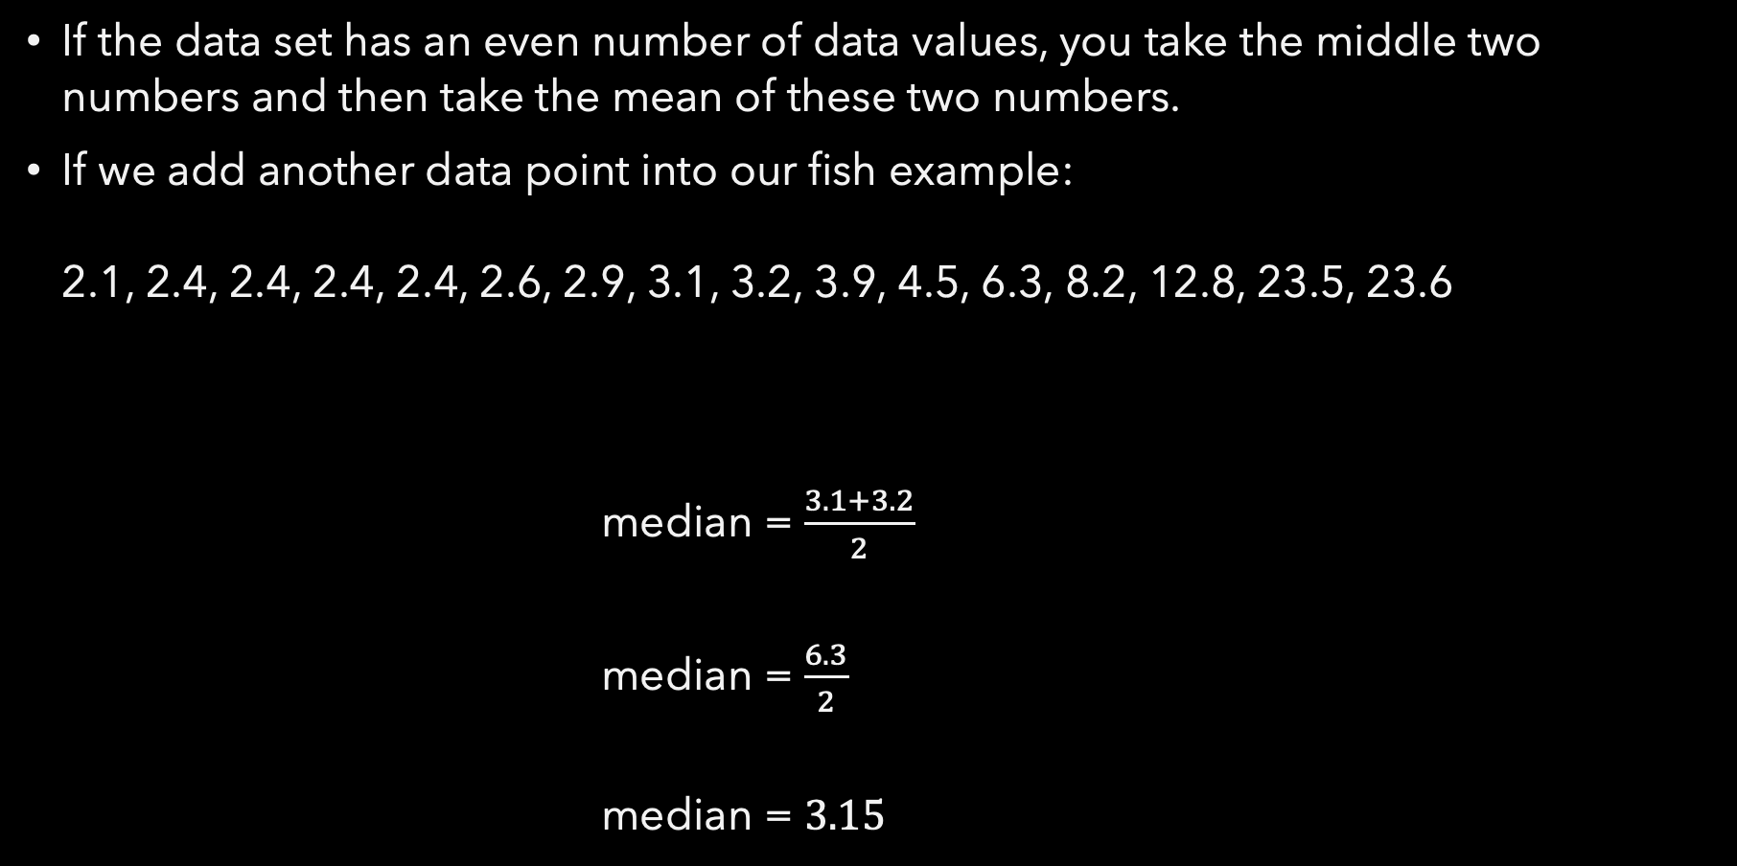
If the data set has an even number of data values, you take the middle two numbers and then take the mean of these two numbers.
If we add another data point into our fish example: 2.1, 2.4, 2.4, 2.4, 2.4, 2.6, 2.9, 3.1, 3.2, 3.9, 4.5, 6.3, 8.2, 12.8, 23.5, 23.6
median = $\frac{3.1+3.2}{2}$
median = $\frac{6.3}{2}$
median = $3.15$

Slide 21
The mode
The mode is merely the data value that is most common, or most frequent, in the data set.
In our fish example: 2.1, 2.4, 2.4, 2.4, 2.4, 2.6, 2.9, 3.1, 3.2, 3.9, 4.5, 6.3, 8.2, 12.8, 23.5
mode = 2.4

Slide 22
Exercise 1
Q1.1: Open the Spyder IDE.
Q1.2: Create a list that contains the following numbers:
5, 8, 3, 6, 8, 10, 3, 8, 6, 10, 5
Q1.2: Use the following NumPy methods to print the measures of central tendency to the screen:
np.mean()
np.median()

Slide 23
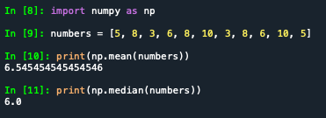
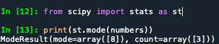
NumPy does not have an in-built function to calculate the mode.
So we use the .mode() method from the Scipy package:
The output shows us that the mode value is 8 and that it appears 3 times in our list of numbers.
Scipy stands for “scientific Python” contains many greats tools for data analysis, and is a package you’ll use a lot as you advance through your course.

Slide 24
Exercise 2
Q2.1: Create a new list that contains the following numbers:
5, 8, 3, 6, 8, 10, 3, 8, 6, 200, 5
Q2.2: Use the following methods to print the measures of central tendency to the screen:
np.mean()
np.median()
st.mode()
Q2.3: What do you see compared to the last exercise?

Slide 25
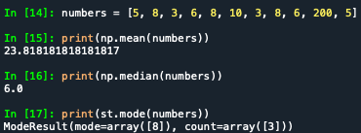

Slide 26
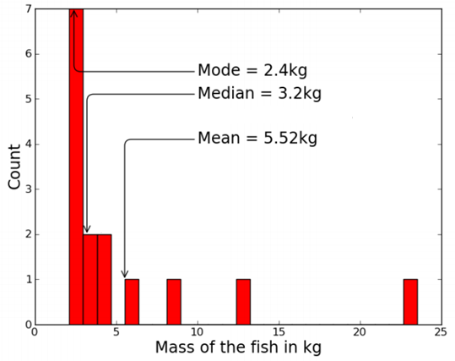
Which measure is best?
There's no perfect way to report the central tendency of a distribution. Each of the measures tell us something.
The median (central score) is a good all-purpose measure, and is not overly influenced by values at the extremes.
The mean is very popular because of some of its mathematical properties, as we will see. But it's very sensitive to extreme values: if the last fish was a 235kg monster, look what happens...

Slide 27
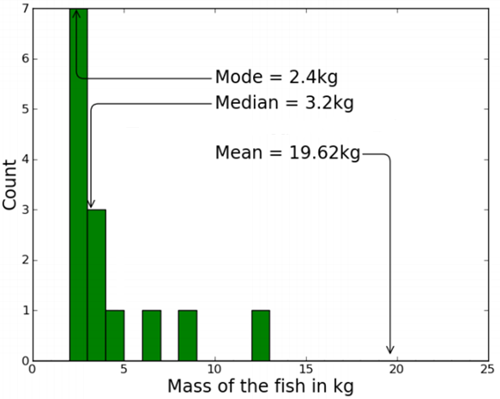

Slide 28
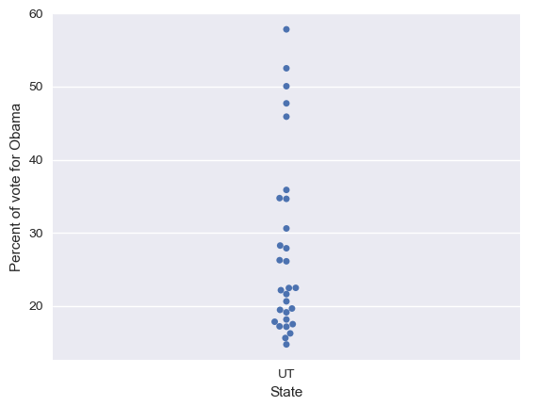
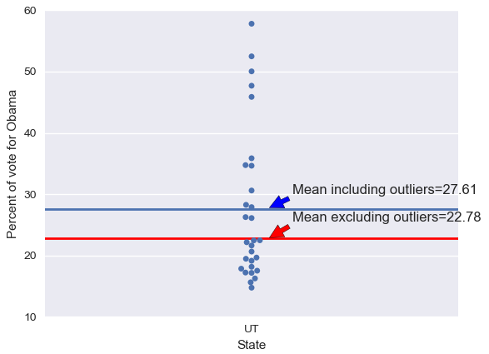
Outliers
Outliers are data points whose value is far greater or far less than the rest of the data points.
We saw this in exercise 2 a moment ago.

Slide 29
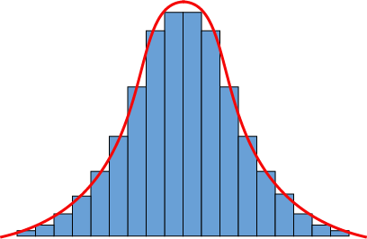
The mean is not "in the middle"
There is a common misconception that confuses the mean with the median in everyday language:
"You know how stupid the average person is? Well, 50% of people are dumber than that!"
Not necessarily so!
Mean and median are roughly equal in symmetrical distributions (right), but if intelligence is distributed in a lop-sided way (previous slide), it will be either more or less than 50% of people who are "dumber than average".

Slide 30
Measuring variation
It's also natural to ask how wide a distribution is. In other words, how spread-out are the scores? How much variation is there?
We could note the minimum and maximum values: between 2.1kg and 23.5kg in the fish case.
We could use these values to calculate a range of 21.4kg. Not a terrible summary of the spread in the fish data?
But, like the mean, the range is very sensitive to extreme values.

Slide 31
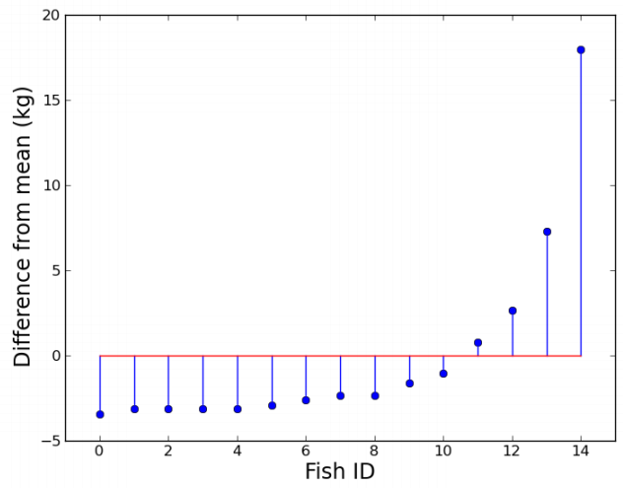
We could be a bit more sophisticated, and start looking at how far our scores differ from the mean.
If we take each fish weights from our example, and subtract the mean of 5.52 from them, we get this new distribution of differences from the mean:
[ -3.42, -3.12, -3.12, -3.12, -3.12, -2.92, -2.62, -2.32, -2.32, -1.62, -1.02, 0.78, 2.68, 7.28, 17.98 ]
Could we use the average of these numbers to describe the variation in the distribution?

Slide 32
Average distance from the mean?
The trouble is that the average distance from the mean is always zero, because the sum of the differences from the mean is zero. (Implicit in the definition of the mean.)
OK, so ignore the signs and take the absolute value of the differences. After all, distance is not usually treated as a signed quantity...
This can work. In the fish case, we get a value of 3.83.
So, on average, a particular fish we catch is 3.83kg away from the overall average of the distribution.

Slide 33
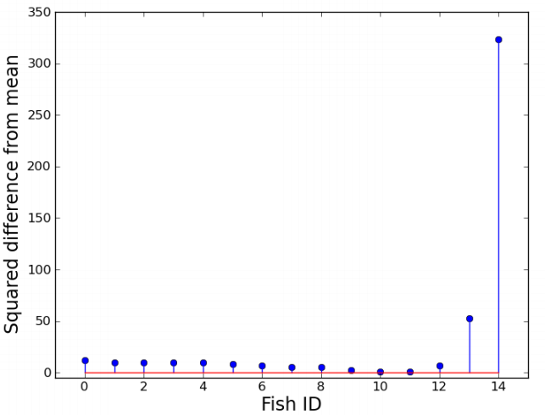
The variance
Average absolute deviation is a sensible-enough measure of variation, but it's not one that is popularly used.
Another way of getting around the average-deviation-adds-to-zero problem is to take the squares of the deviations.
This move turns out to have a lot of useful properties...

Slide 34
If we take the average of these squared differences from the mean, this is called the variance.
In the fish case, the variance is 30.97.
This is a good measure of variation: if someone else's fish catch had a variance of 40, we would know that their fish weights were more spread-out than ours.
However, the variance is in the odd unit of kilograms squared...

Slide 35
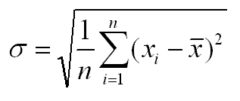
The standard deviation
We solve this problem by taking the square root of the variance to get a new measure called the standard deviation.
We are now back in the familiar units of kilograms.
The standard deviation in the fish case is 5.56kg, a bit higher than the mean absolute deviation of 3.83kg.
The standard deviation is by far the most popular measure of variation in a distribution.

Slide 36
Exercise 3
Q3.1: Create a new list that contains the following numbers:
5, 8, 3, 6, 8, 10, 3, 8, 6, 200, 5
Q3.2: Use the following methods to print the variation measure:
np.ptp() – gives the range
np.var()
np.std()
Q2.3: What do you see?

Slide 37
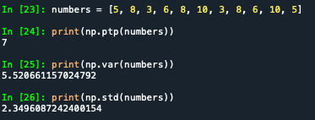

Slide 38
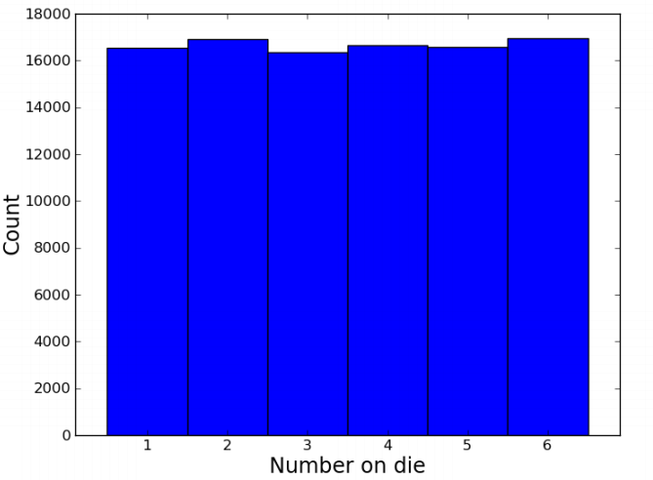
Distribution arithmetic
If we try to put two distributions together, we find one of the nice properties of the variance.
Let's take a dice-throwing example.
The graph shows the observed distribution for 100,000 simulated throws of a six-sided die.
- Mean = 3.507
- Standard deviation = 1.712
- Variance = 2.930

Slide 39
What if we wanted to look at the sum of two dice?
We are adding two distributions together here; the distribution of dice A results, added to the distribution of dice B results.
Is the arithmetic straightforward? Can we add one mean to another, and one standard deviation to another, to predict the two-dice result?

Slide 40
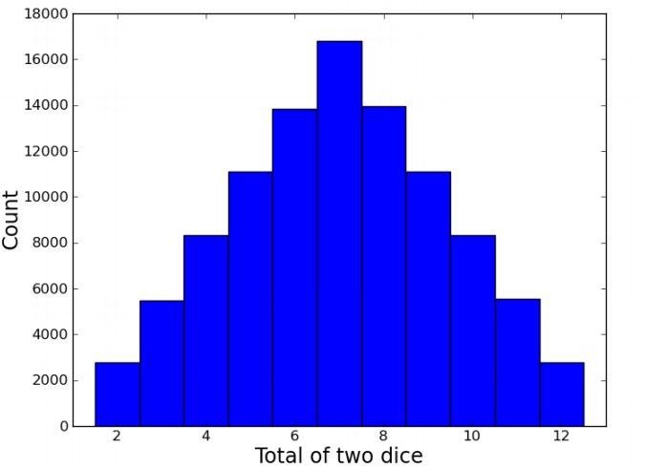
In the two-dice case, after 100,000 throws:
- Mean = 7.003
- Standard deviation = 2.411
- Variance = 5.814
The means add up pretty well: 3.507 + 3.507 ≈ 7.003
The standard deviations do not; 1.712 + 1.712 ≠ 2.411
But the variances are additive! 2.930 + 2.930 ≈ 5.814. This is generally true for independent random variates.

Slide 41
Samples vs. populations
In the dice-throwing case we used a large sample size (100,000 throws) in order to get close to the theoretical infinitely-long-run values.
This reminds us that there is a big difference between the distribution of a population (e.g., all theoretical dice throws ever or all the people currently alive) and a sample distribution; i.e., what happened on the last 10 dice throws or my random sample of 50 people.
Indeed, as mentioned previously, a large amount of statistical work is concerned with how representative of a population distribution a sample distribution is.

Slide 42
Populations and samples
Population (N)
Sample (n)

Slide 43
The need for sampling
Given that populations are often large, sometimes infinite. We therefore have no alternative but to sample the population in some way.
Statistics has its roots in the effort to figure out just what you can reasonably infer about this wider population from the sample you've got.
The size of your sample turns out to be an important limiting factor.

Slide 44
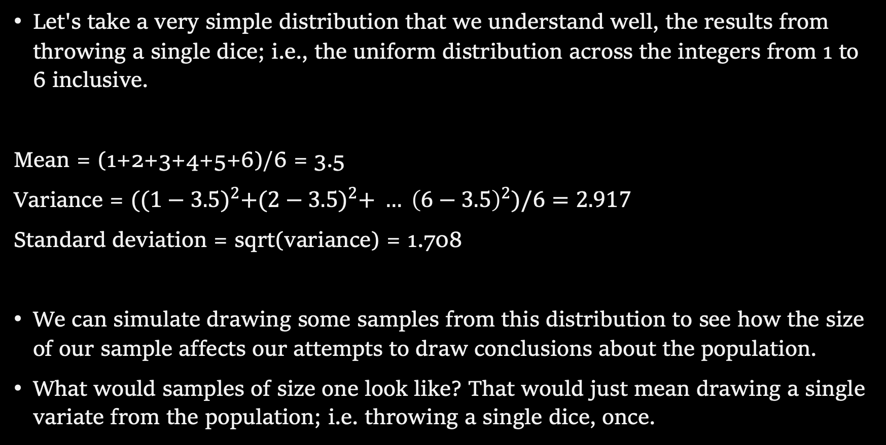
Sampling from a known distribution
Let's take a very simple distribution that we understand well, the results from throwing a single dice; i.e., the uniform distribution across the integers from 1 to 6 inclusive.
Mean = (1+2+3+4+5+6)/6 = 3.5
Variance = ${((1−3.5)}^{2}+{(2−3.5)}^{2}+ … {\left(6−3.5\right)}^{2})/6=2.917$
Standard deviation = sqrt(variance) = 1.708
We can simulate drawing some samples from this distribution to see how the size of our sample affects our attempts to draw conclusions about the population.
What would samples of size one look like? That would just mean drawing a single variate from the population; i.e. throwing a single dice, once.

Slide 45
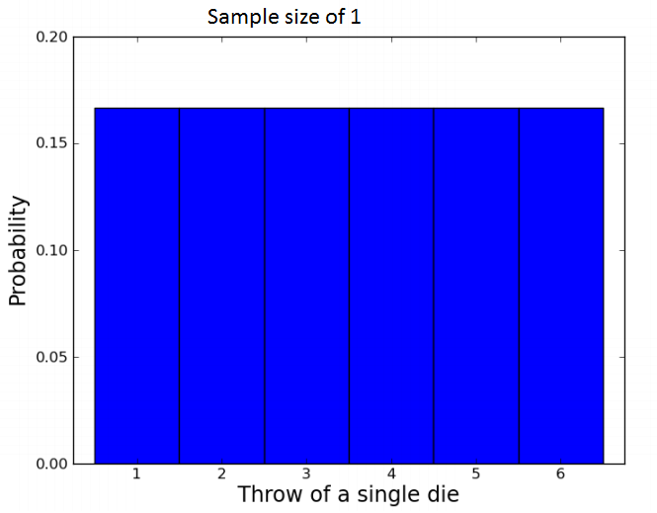
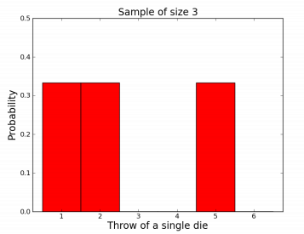
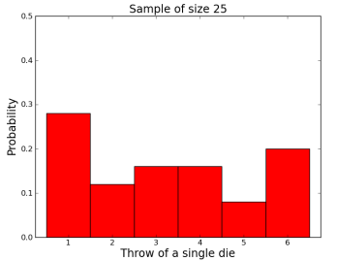
Some samples
A small sample of 3
observations gives a mean of
2.667.
A larger sample of 25
observations gives a mean of
3.240.
A sample consisting of only 1 role gives a mean of 3.5.

Slide 46
Samples give us varying results
In both cases we didn't reproduce the shape of the true distribution nor get exactly 3.5 as the mean, of course.
The bigger sample gave us a more accurate estimate of the population mean which is hopefully not too surprising.
But how much variation from the true mean should we expect if we kept drawing samples of a given size?
This leads us to the "meta-property" of the sampling distribution of the mean: let's simulate drawing a size 3 sample 10,000 times, calculate the sample mean, and see what that distribution looks like...

Slide 47
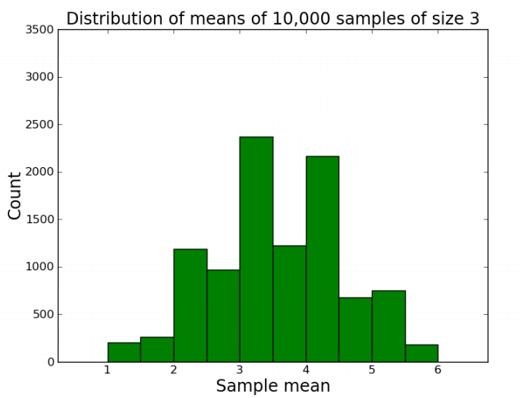
For the sample-size-3 case, it looks like the mean of the sample means centres in on the true mean of 3.5.
But there's a lot of variation. With such a small sample size, we can get extreme results such as a sample mean of 1 or 6 reasonably often.
Do things improve if we look at the distribution of the sample means of sample of sizes 25 and 100 for example?

Slide 48
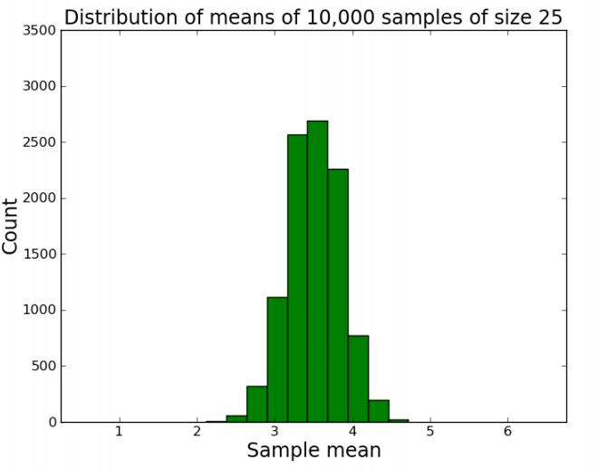
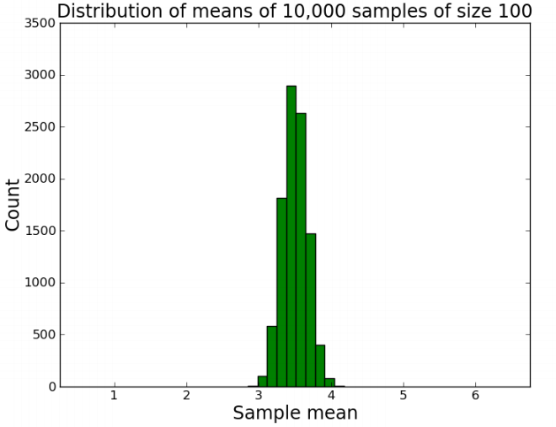

Slide 49
Sample distribution of the mean
So there are a few things going on here...
The distribution of the sample means looks like it is shaped like a bell curve, despite the fact that we've been sampling from a flat (uniform) distribution.
The width of the bell curve is getting gradually smaller as the size of our samples go up. So bigger samples seem to give tighter, more accurate estimates.
Even for really small sample sizes, like 3, the sample mean distribution looks like it is centred on the true mean, but for a particular sample we could be way off.

Slide 50
Central Limit Theorem
The central limit theorem dictates that means calculated from samples with larger sample sizes tend to lie closer to the true mean than the means calculated from samples with smaller sample size.

Slide 51
Confidence intervals
The purpose of taking a random sample from a lot or population and computing a statistic, such as the mean from the data, is to approximate the mean of the population. As we have seen, how well the sample statistic estimates the underlying population value is always an issue.
A confidence interval it tells you how confident you can be that the results from a sample reflect what you would expect to find if it were possible to survey the entire population.

Slide 52
The need for confidence intervals
Remember, due to natural variations within the population, variation between different random samples is an inevitable result of the sampling process; this is known as sampling variation.
Although sampling variation cannot be eliminated, the use of confidence intervals allows us to quantify how much variation to expect under different conditions, and this allows us to gain some measure of the confidence with which we can make predictions about the population.

Slide 53
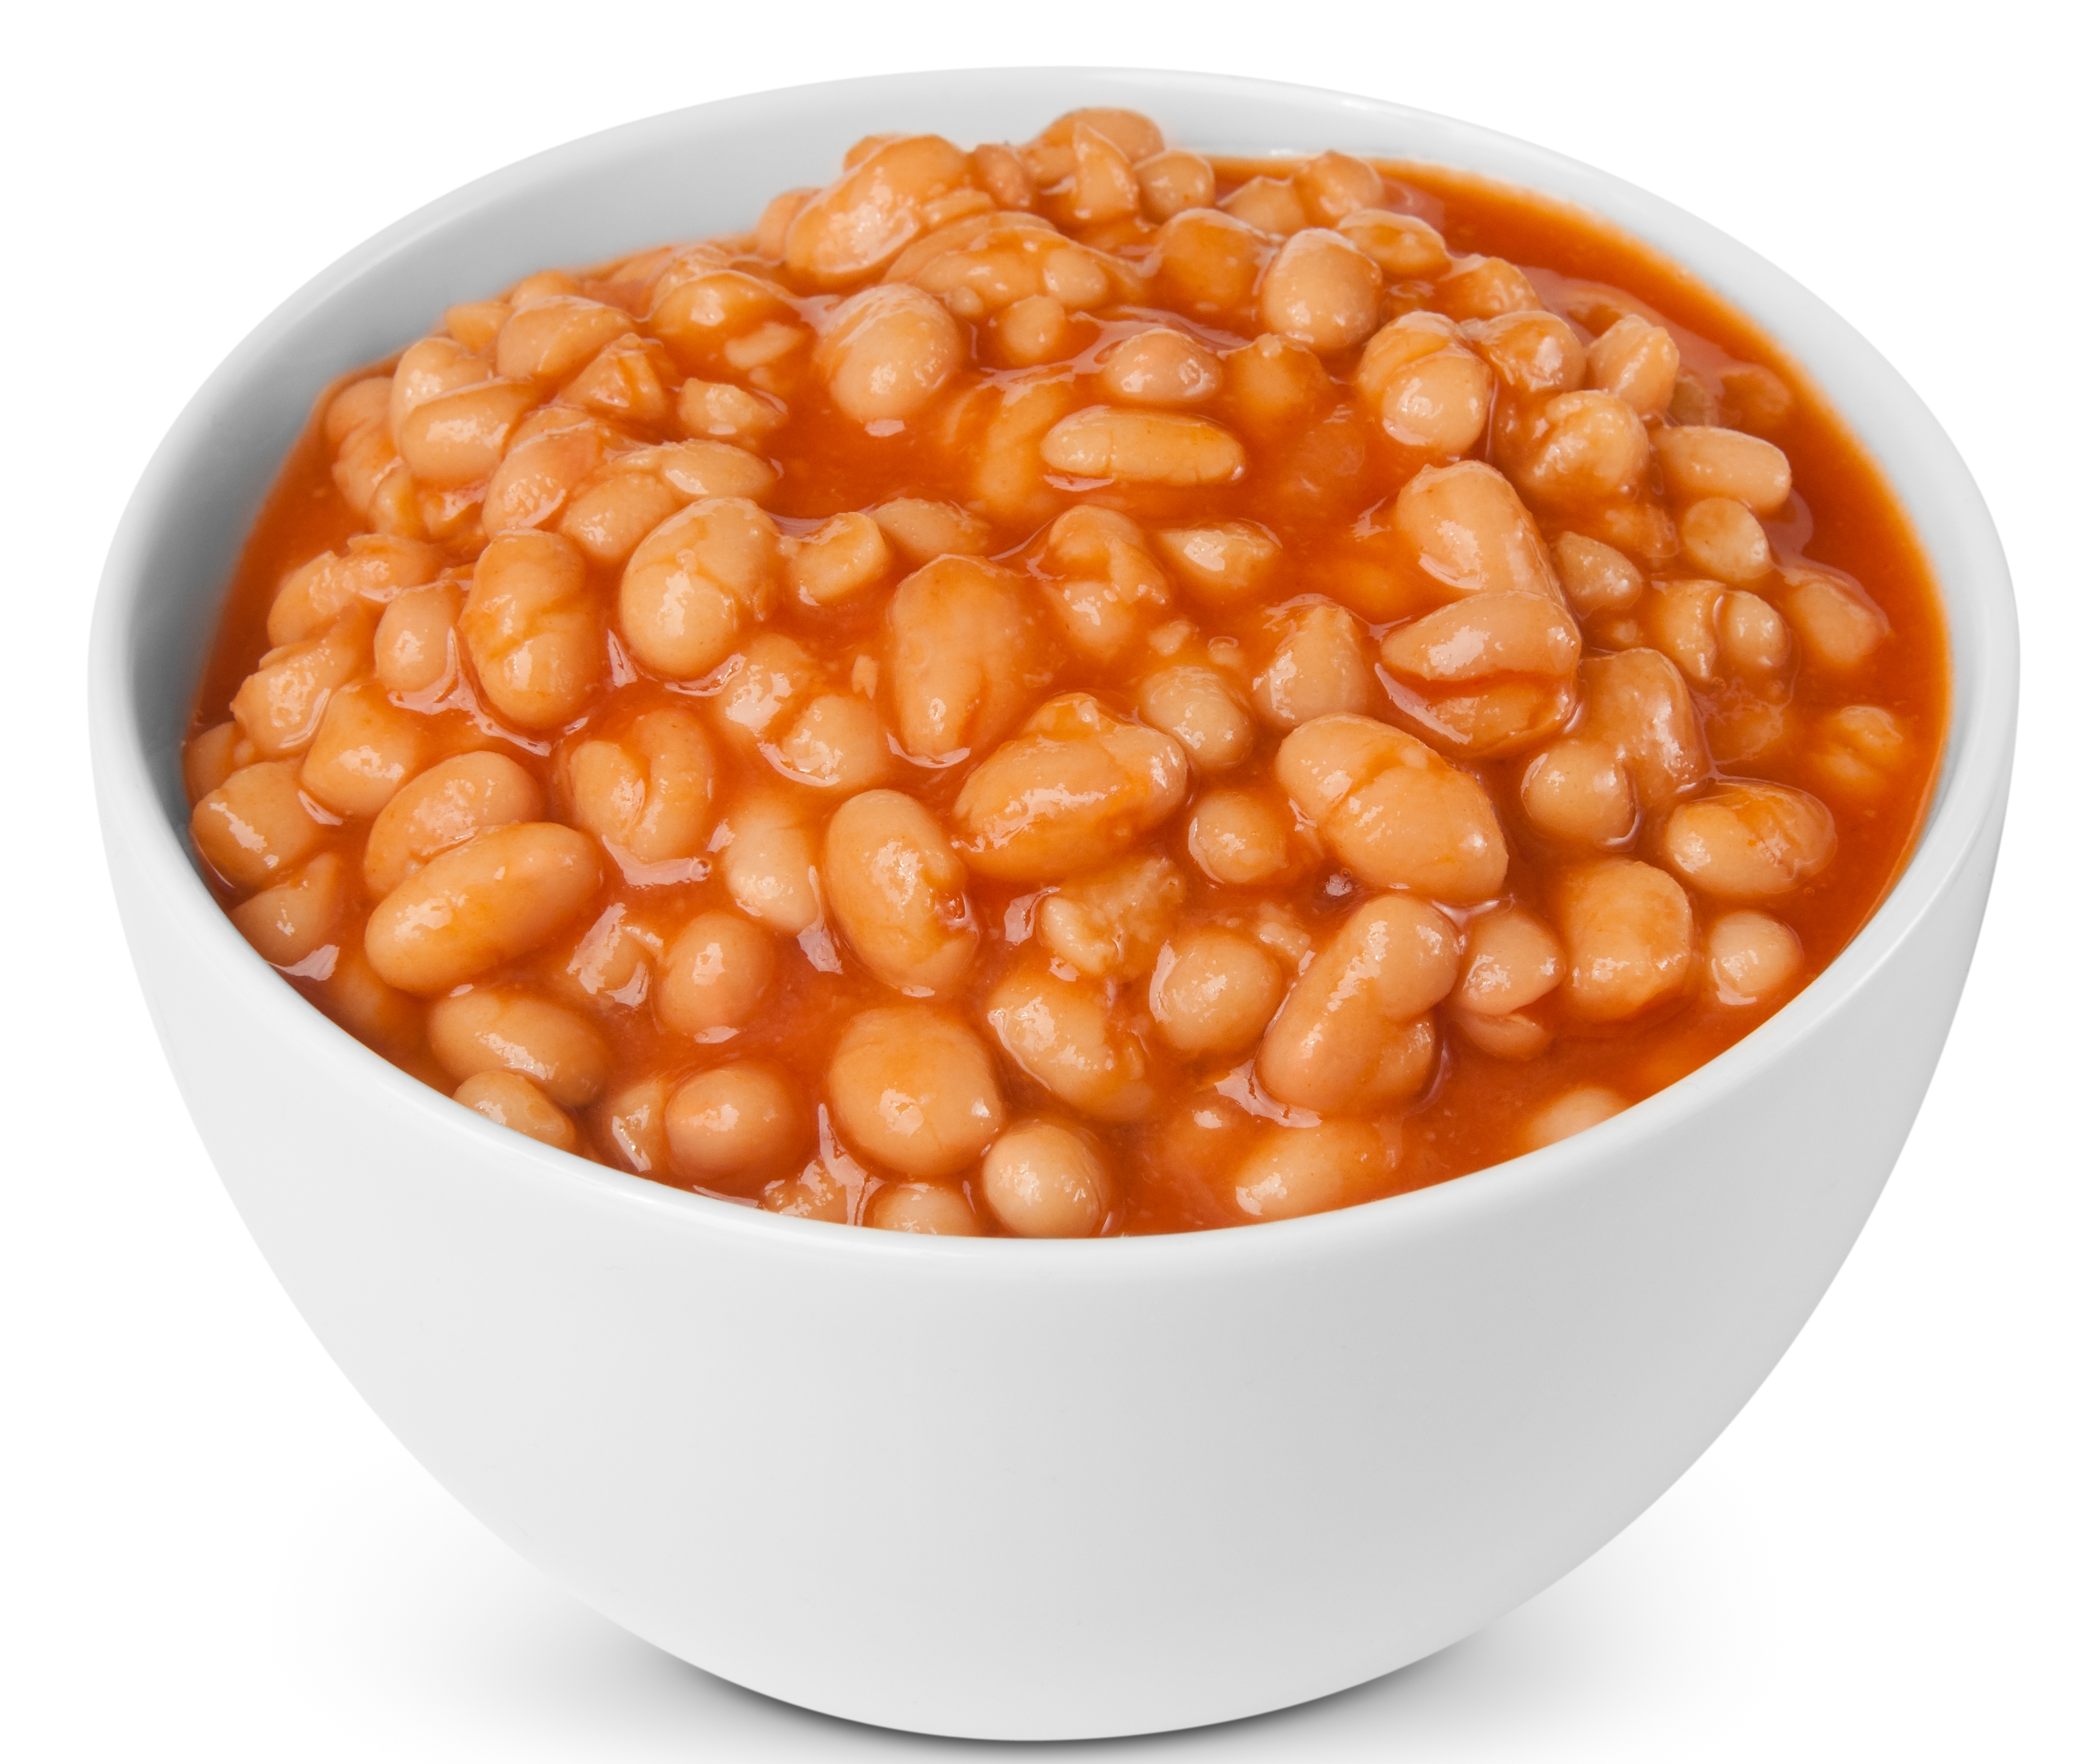
An example
Let’s imagine that we work for a manufacturer of baked beans, and that we are tasked with the company’s quality and control procedures.
We regularly weigh 100 tins of beans so as to ensure that they are of the required weight of 415g.
This then presents us with an investigative question: “What is the mean weight of all tins of beans produced by the manufacturer?”

Slide 54
We draw a sample:
n = 100
Lightest weight = 414g
heaviest weight = 423g
mean = 418.34
standard deviation = 2.69
We can then use this information to calculate the confidence interval for this sample.
Nowadays we would just tell the computer to do this for us. However, it is useful to spend sometime understanding how the calculation works.

Slide 55
Remember, two things will impact the confidence interval; variation in the population and sample size.
We obviously don’t know the variation of the population, but the variation in the sample will serve as an indicator of the amount of variation in the population:
- We will be using the standard deviation of the sample as a measure of the variation in the population.
Remember that the standard deviation tells us the average distance that the values in the sample are from the sample mean.

Slide 56
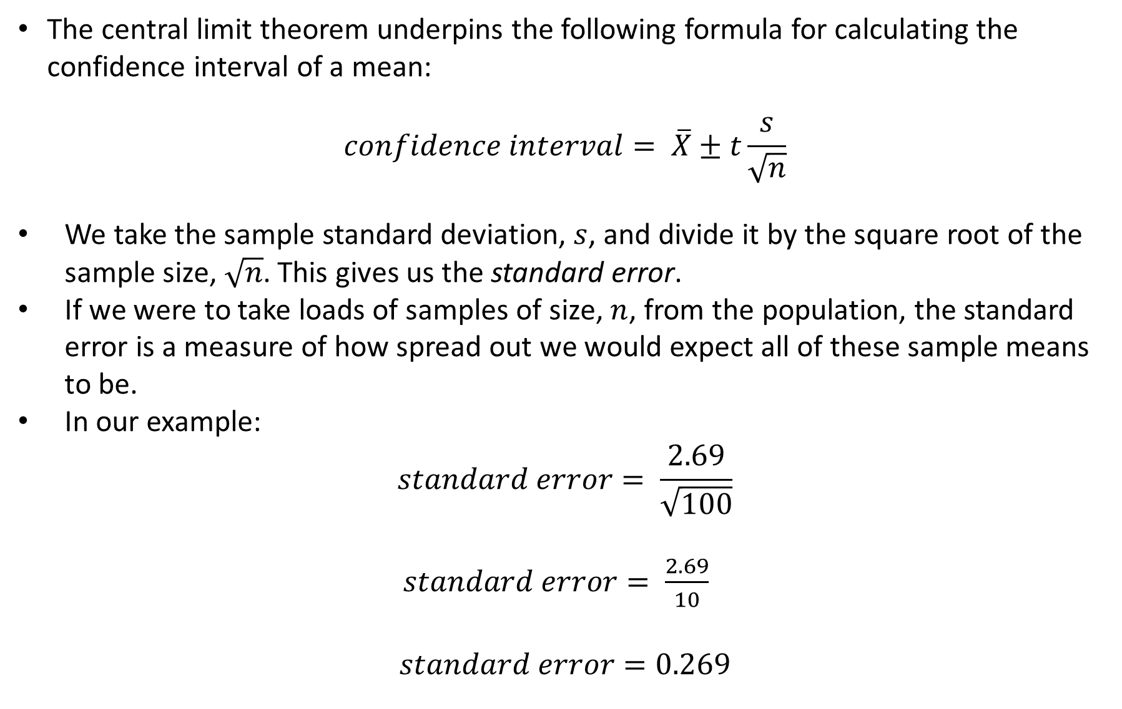
The central limit theorem underpins the following formula for calculating the confidence interval of a mean:
$$confidence interval= \overline{X}±t\frac{s}{\sqrt{n}}$$
We take the sample standard deviation, $s$, and divide it by the square root of the sample size, $\sqrt{n}$. This gives us the standard error.
If we were to take loads of samples of size, $n$, from the population, the standard error is a measure of how spread out we would expect all of these sample means to be.
In our example: $standard error= \frac{2.69}{\sqrt{100}}$
$standard error= \frac{2.69}{10}$
$$standard error=0.269$$

Slide 57
It is interesting that we use the square root of the sample size.
This reflects the phenomenon that the more information we have, the less information we get from one more observation in the sample.
It means that increasing our sample size from 10 to 20 would give more information and thus decrease the confidence interval more, than increasing the sample size from 100 to 110.

Slide 58
In traditional confidence intervals, we also want to specify the level of confidence.
The more confident we wish to be, the larger the confidence interval will be.
If we wanted to be sure that we are capturing the population parameter, we could use a very wide confidence interval; i.e. we could say that the parameter for the population is between one and one million.
However, that is clearly not useful.

Slide 59
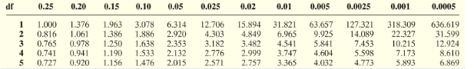


Instead, we use a value from the t-distribution in our formula.
These can be read off of a table:
Here, $t$ depends upon the sample size and the chosen level of confidence.
The bigger the $t$ value is, the bigger our confidence interval will be.
Let’s say that we want a 99% confidence level.
We have a sample of size 100.
If this table went down to size 100, we would see that the $t$ value would be 2.626.

Slide 60


We then multiple the standard error by the $t$ value to get the margin of error.
$$margin of error=t\frac{s}{\sqrt{n}}$$
$$margin of error=2.626∗0.269$$
$$margin of error=0.70$$

Slide 61
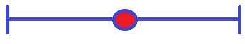




We now add and subtract the margin of error from the sample mean to get the confidence interval.
$$confidence interval= \overline{X}±t\frac{s}{\sqrt{n}}$$
$$confidence interval=418.34±0.70$$
$$lower confidence interval=418.34 − 0.70$$
$$upper confidence interval=418.34+ 0.70$$
$$lower confidence interval=417.64$$
$$upper confidence interval=419.04$$
This confidence interval gives us a range of values that we can be pretty sure, or confident, contains the mean from the population.
$$417.64$$
$$419.04$$
Remember! This is NOT the interval that will hold the weight of 95% of the tins produced. It is the interval that we are 95% sure will contain the true value of the unknown population mean weight

Slide 62
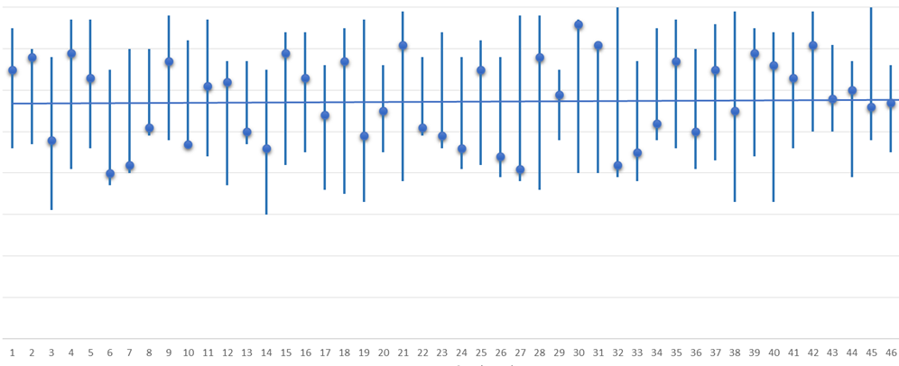
In other words, if we were to take a load of samples from the population, of size 100, and create 99% confidence intervals for them, we would expect most of them (99% of them) to contain the true population mean.
If we used a 95% confidence interval, we could say that the same would be true 95% of the time; and so on for other values.
Confidence levels of 95% and 99% are the most commonly used, purely because of statistical convention.
However, this means that 1% of them would not contain the population mean.
We cannot be sure whether a sample does truly contains the population mean.

Slide 63
End of Session 10

